Slide 1

Pharmacy system

Slide 2
Team Members
AbdelRahman Abbass
AbdelRahman Mohamed
Ehab Ashraf
Aya abdelNaby
Ayat Ashraf
Ayat Adel

Slide 3
This Application Is designed to provide admin to control his system and edit the medicines’ and agent’ data .

Slide 4
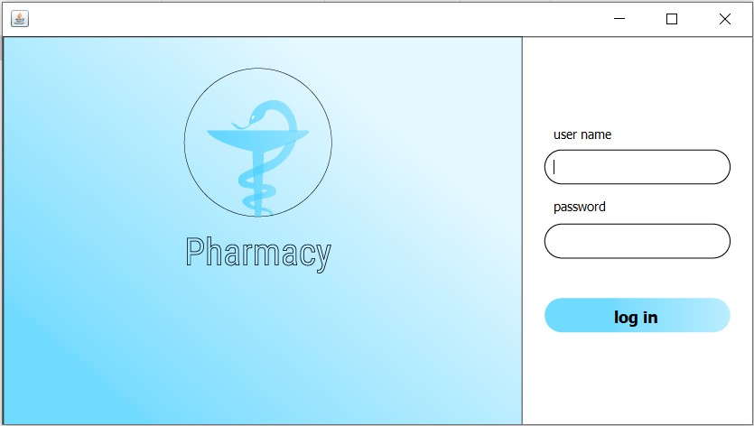
Log in Frame
Write the
user name
Write the
password
To log in

Slide 5
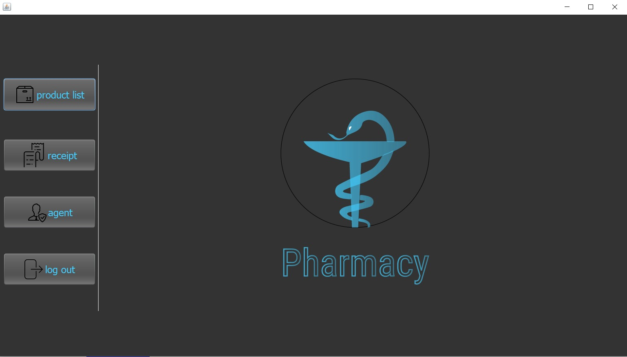
The Main Frame
Open Product list
Frame
Open Receipt
Frame
Open Agent
Frame
Enter to
log out

Slide 6
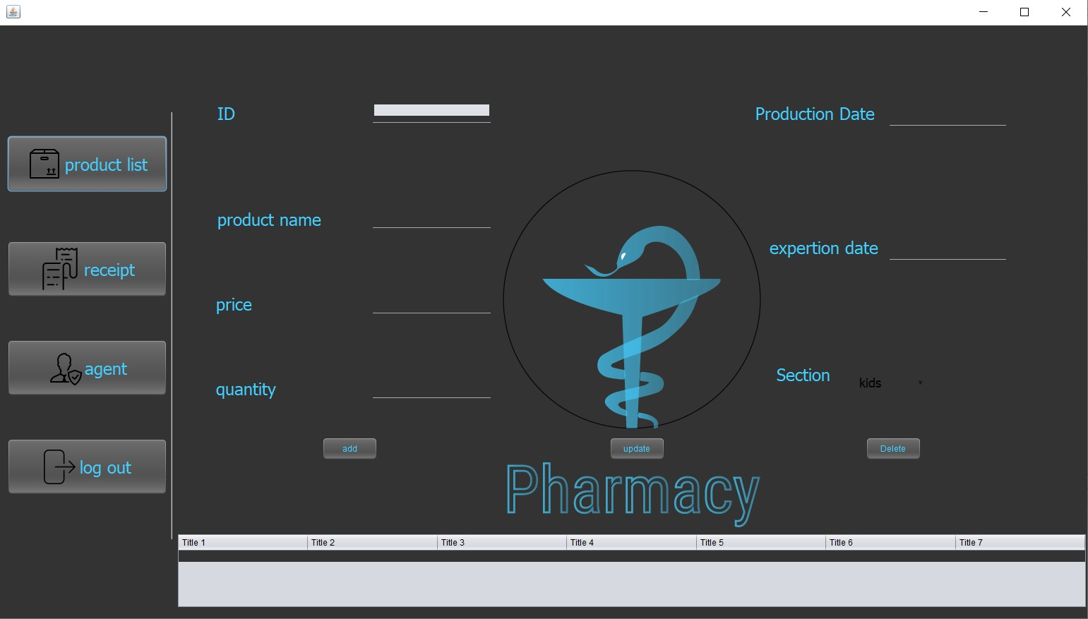
Product List Frame
Product
properties
The Operation
on data
Product data

Slide 7
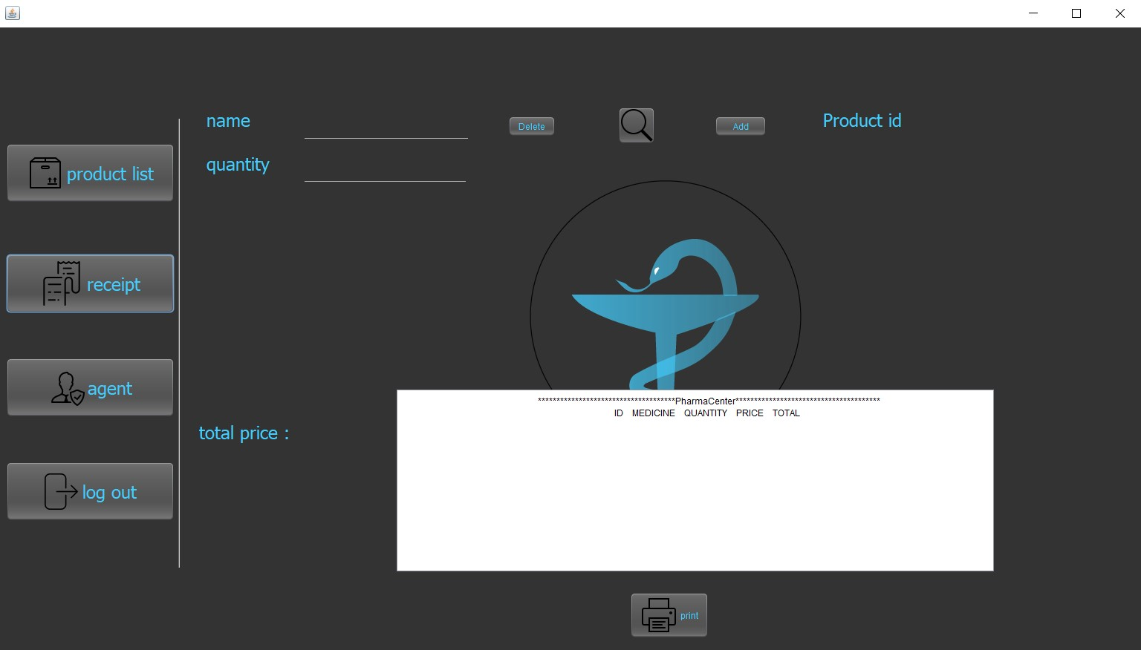
The Receipt Frame
To search
a products
The Products
Receipt
To Print the Receipt

Slide 8
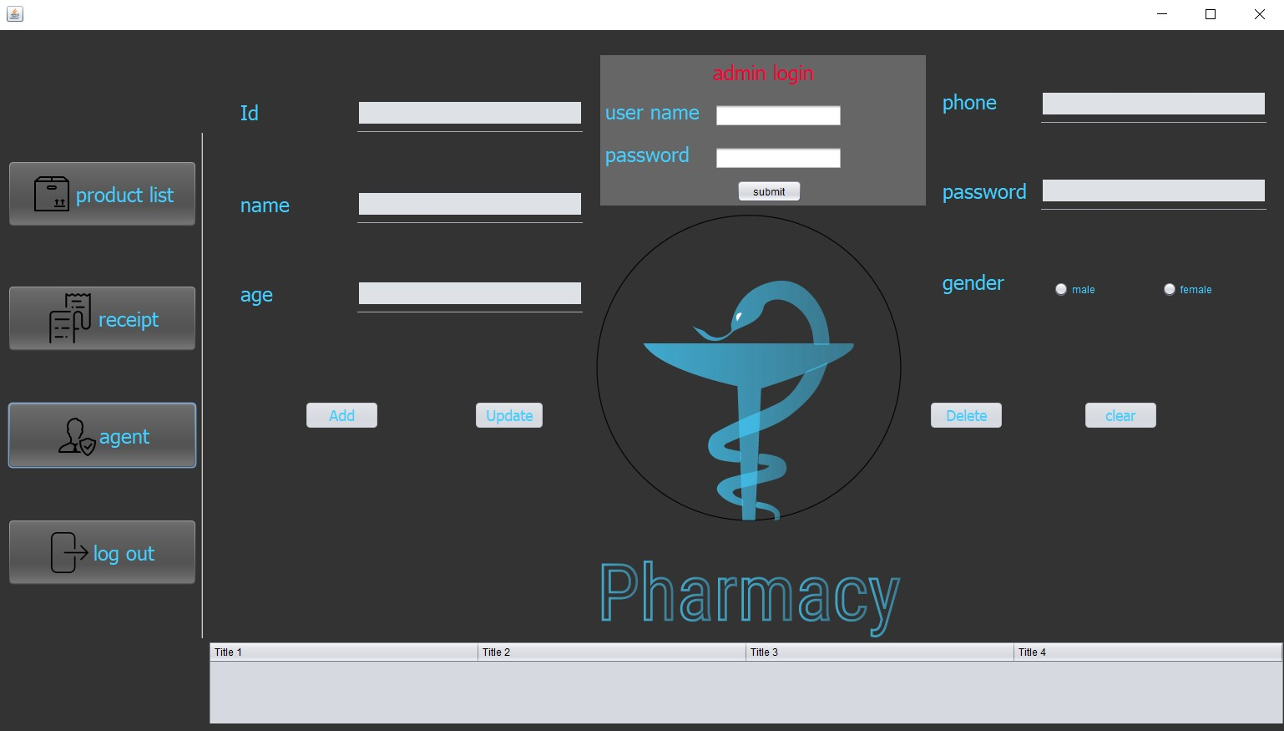
The Agent Frame
To Enter Agent to this
Frame
Agent
properties
Operation on
Agent data
Agent data

Slide 9
Thank you

